Slide 1



TITLE:
KONGU ENGINEERING COLLEGE
BATCH NO :18
HEALTHCARE BOOKING HUB
GUIDED BY: Dr. M. JAGADEESAN M.CA.,M.Phil.,Ph.D.,
TEAM MEMBERS:
HARINI MADURA M (24MCR030)
JEEVA A (24MCR044)
KEERTHANA M (24MCR055)

Slide 2
OBJECTIVE:
A Healthcare booking hub allow to create a seamless and user-friendly platform for patients and doctors to efficiently organize appointments.
Patients can search for doctors based on specialties, view their calendars, and book appointments. Doctors may manage their schedules, see patient appointments, and adjust their availability.
This technology reduces the traditional inconveniences of appointment scheduling
by providing a digital, user friendly solution that increases productivity for both
healthcare practitioners and patients.

Slide 3
EXISTING DRAWBACKS:
Limited Access and Availability.
Difficulty Accessing Specialized Services.
Limited real-time availability.
Lack of Customization for Patients.

Slide 4
PROBLEM STATEMENT:
The hospital has fixed operating hours and customer should visit only in those
hours.
Issues such as outdated design, poor navigation, and limited functionality are
negatively impacting user experience.
Payment options may be limited to cash in physical stores.
To overcome those customer drawbacks we are introducing healthcare booking hub.

Slide 5
PROPOSED ADVANTAGES:
Real-Time Availability and Smart Scheduling:
Benefit: Patients will get immediate confirmation of appointments, while doctors can manage their schedules more efficiently.
Improved Patient Convenience:
Benefit: Patients can view available time slots and choose those that best fit their schedule without needing to call multiple times, wait on hold, or play phone tag with the provider’s office.

Slide 6
MODULE DESCRIPTION:
The project contains four modules such as,
Admin Module
Doctor Module
User Module
Payment Module

Slide 7
ADMIN MODULE:
In this module admin manages most of the activities such as uploading the doctor’s list and view latest booking.
Admin can manage the appointments.
Admin can view the patients.
DOCTOR MODULE:
Doctors can login through their specified login Id.
Doctor can manage the appointments like accept or cancel the bookings.
Doctors can edit their profile and can view their earnings.

Slide 8
USER MODULE:
Customer can use this website to view different types of doctor and book appointment.
Doctor’s with high quality images, detailed descriptions with certified doctor.
Users can filter the doctors and view their appointments and can edit their profile.
User can view available time slots and doctors.
PAYMENT MODULE:
These are the features that allow patient to pay for appointments, such as credit or debit card payments.

Slide 9
DATABASE DESIGN:
DOCTOR:
{
"name": "Dr. Emily Clark", "email": "emilyclark@example.com",
"password": "hashed_password",
"image": "image_url_or_base64“,
"speciality": "Dermatologist",
"degree": "MD, Dermatology",
"experience": 10,
"about": "Board-certified dermatologist“,
"available": true,
"fees": 200.00,
"address": "789 Pine St,
"date": "2024-10-25",
"slots_booked": [ { "slotDate": "2024-11-01", "slotTime": "09:30", "patientID": "patient_12345" }]
USER: {
"name" : "Alice Smith",
"email" : alicesmith@example.com",
"password": "hashed_password",
"image":"image_url",
"address": "456 Elm St,USA",
"gender": "Female",
"dob": "1985-06-15",
"phone": "+19876543210"
}

Slide 10
APPOINTMENTS
{
"userID": "user_12345",
"docID": "doc_98765",
"slotDate": "2024-11-01",
"slotTime": "15:30",
"userData": { "name": "Alice Smith",
"email": "alicesmith@example.com",
"phone": "+19876543210"
},
"docData": { "name": "Dr. John Doe",
"specialization": "Cardiologist",
"email": "johndoe@clinic.com"
},
"amount": 150.00,
"date": "2024-10-25",
"cancelled": false,
"payment": { "method": "Credit Card",
"transactionID": "txn_123456789",
"status": "Completed“
},
"isCompleted": false
}

Slide 11
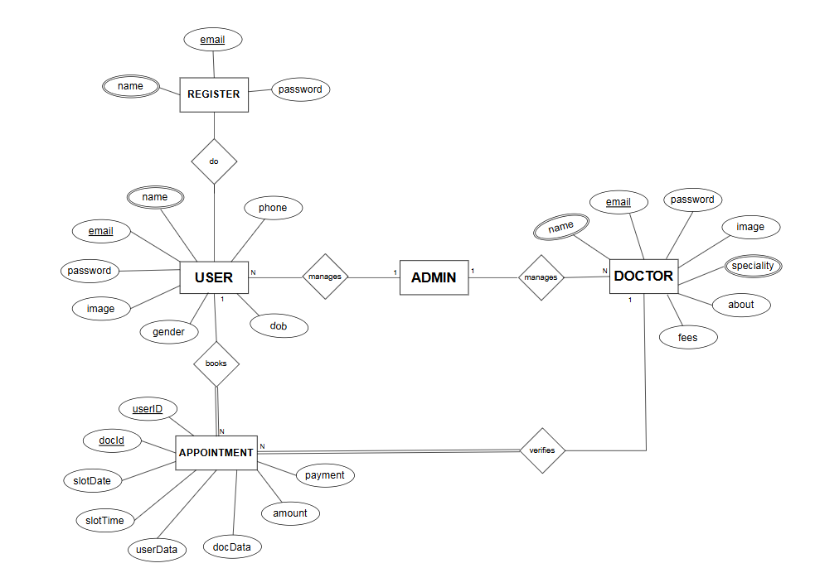
ER-DIAGRAM

Slide 12
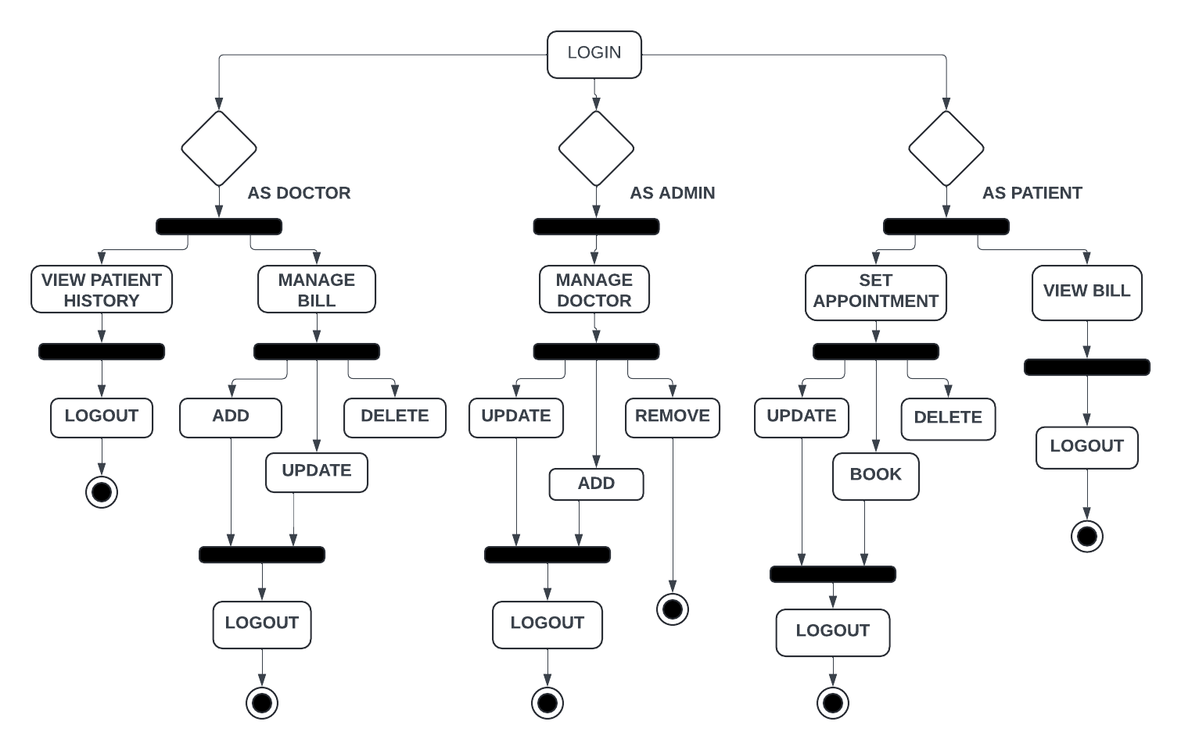
ACTIVITY DIAGRAM

Slide 13
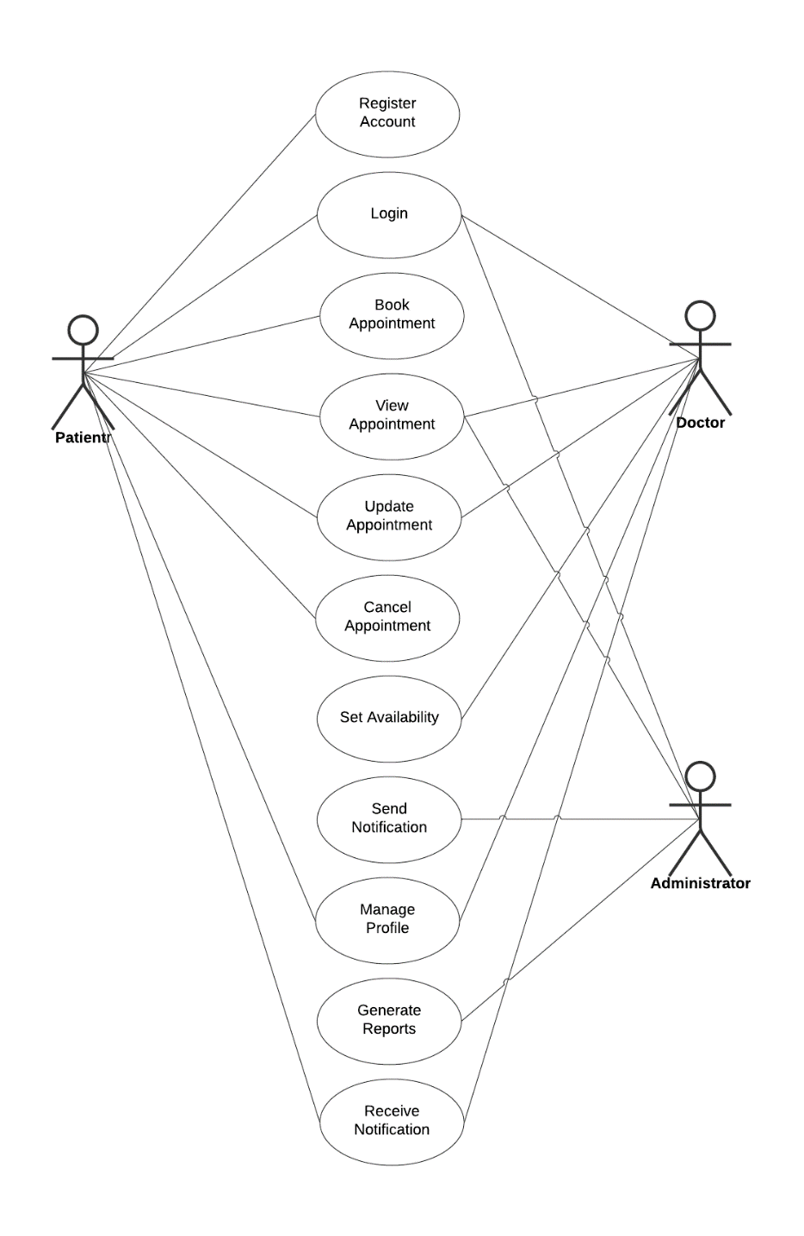
USECASE DIAGRAM

Slide 14
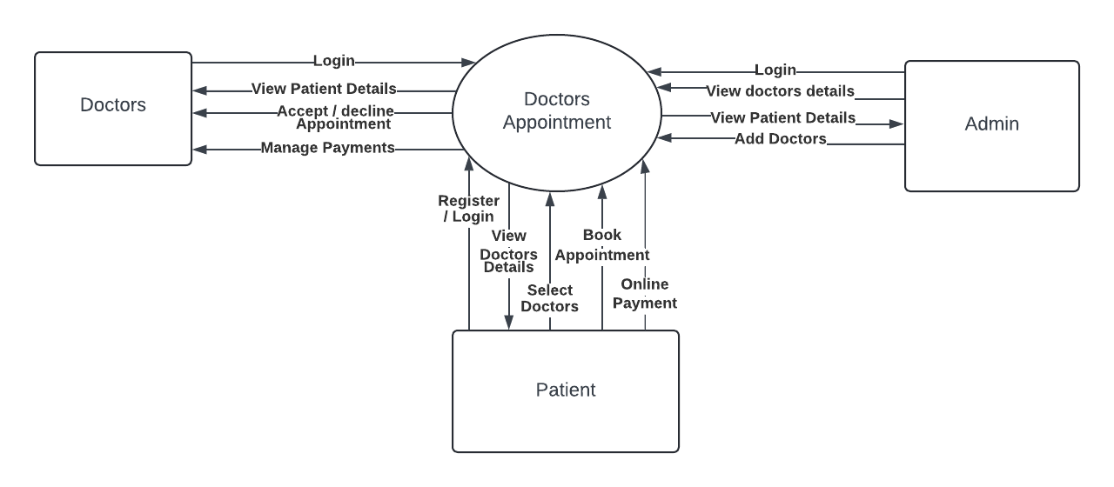
DATA FLOW DIAGRAM
LEVEL 0

Slide 15
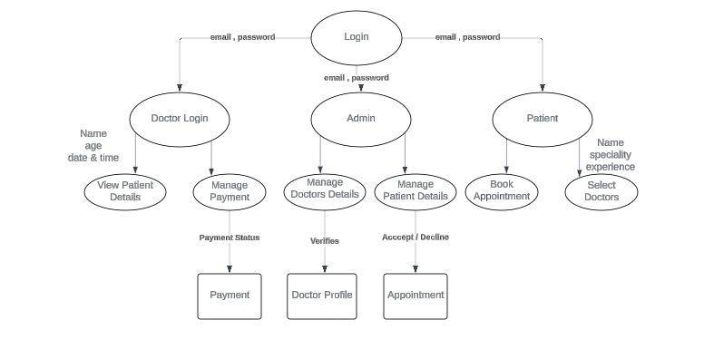
LEVEL 1

Slide 16
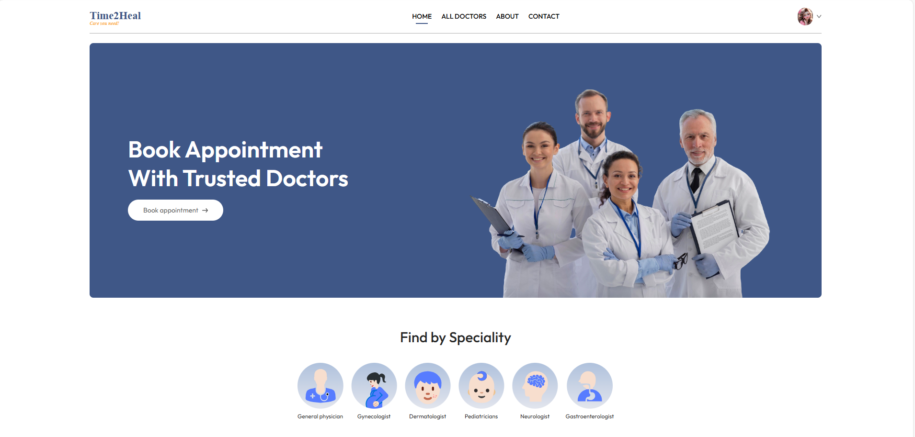
/
Home Page

Slide 17
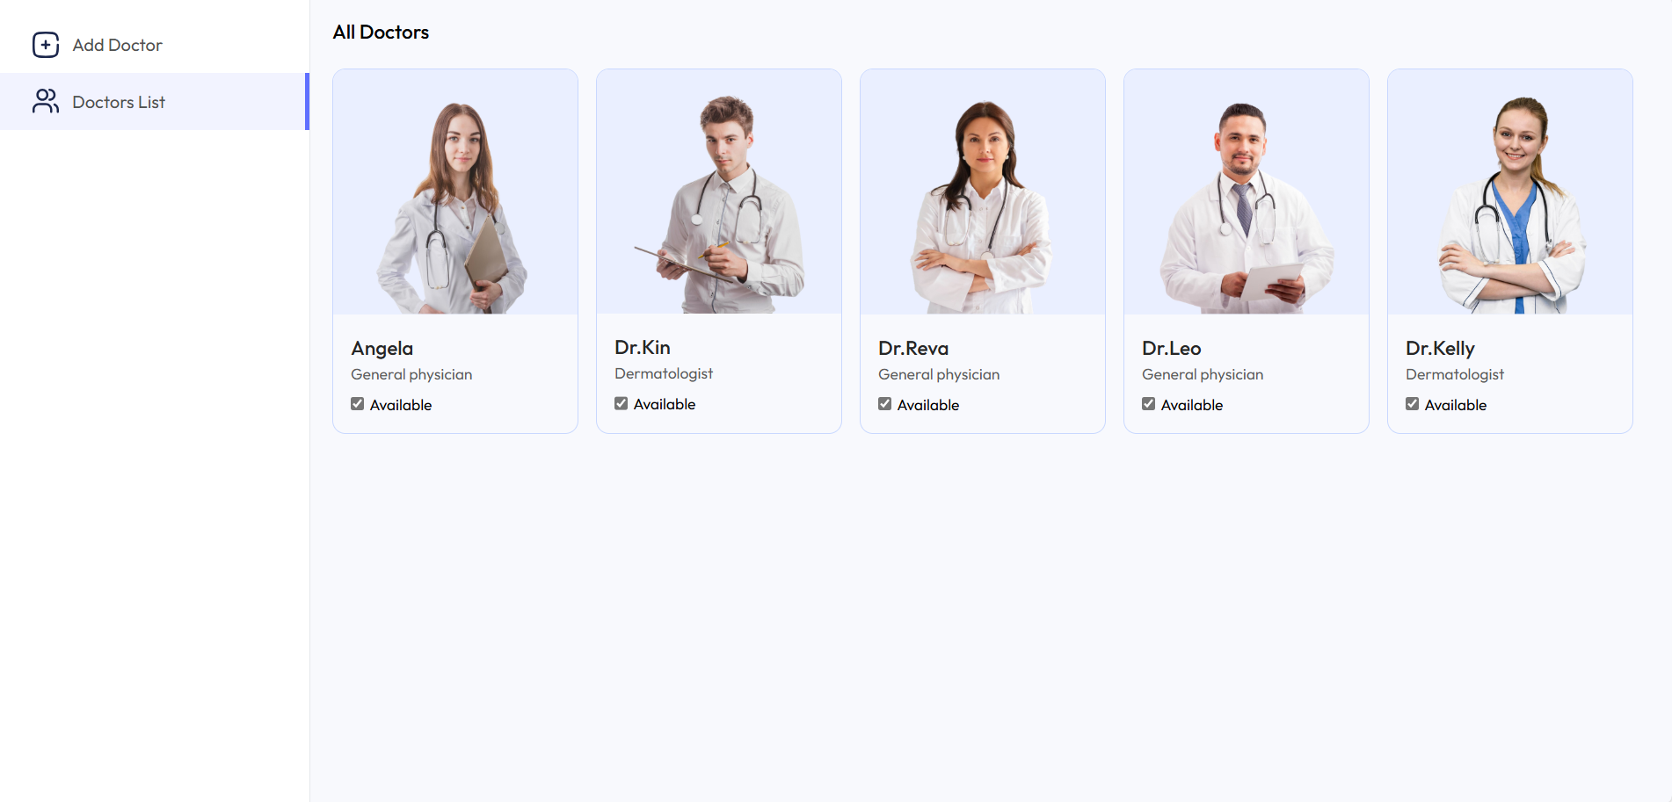
All Doctors

Slide 18
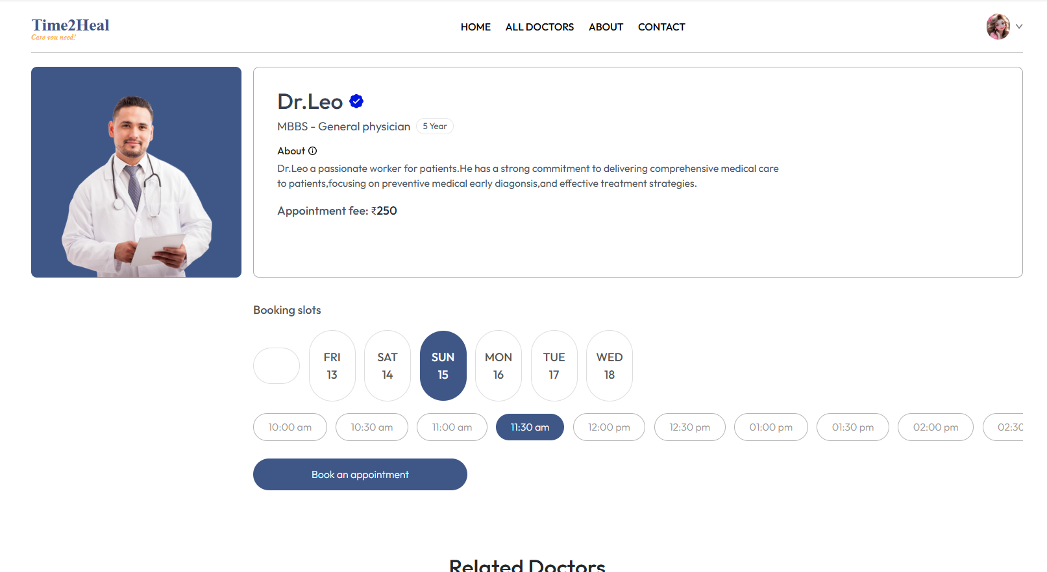
Appointment Bookings

Slide 19
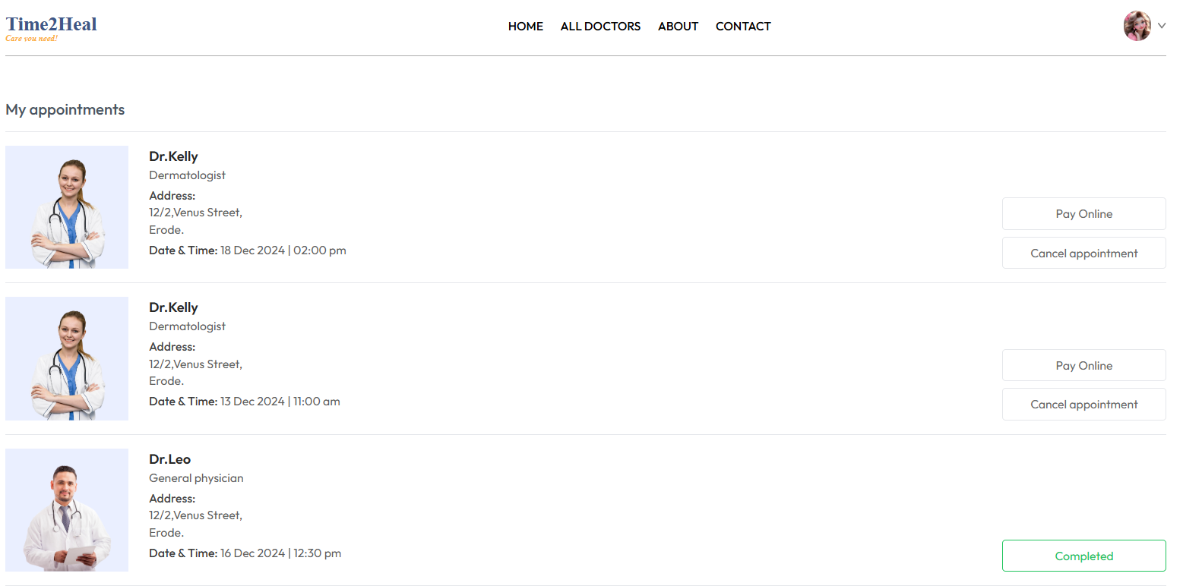
My Appointments

Slide 20
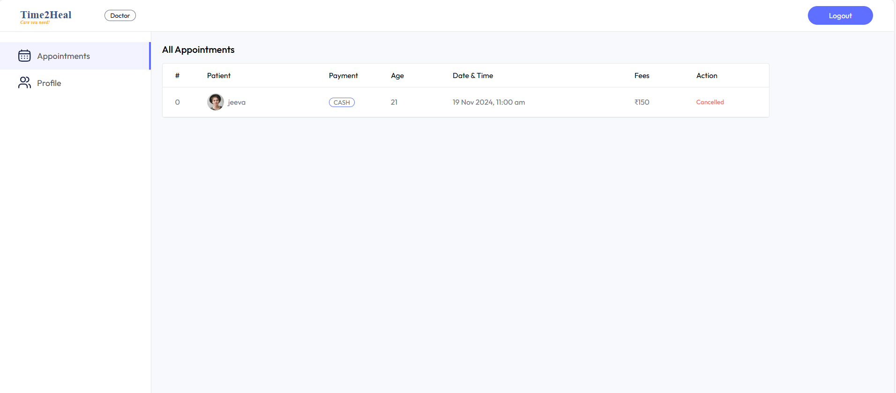
Doctors Appointment

Slide 21
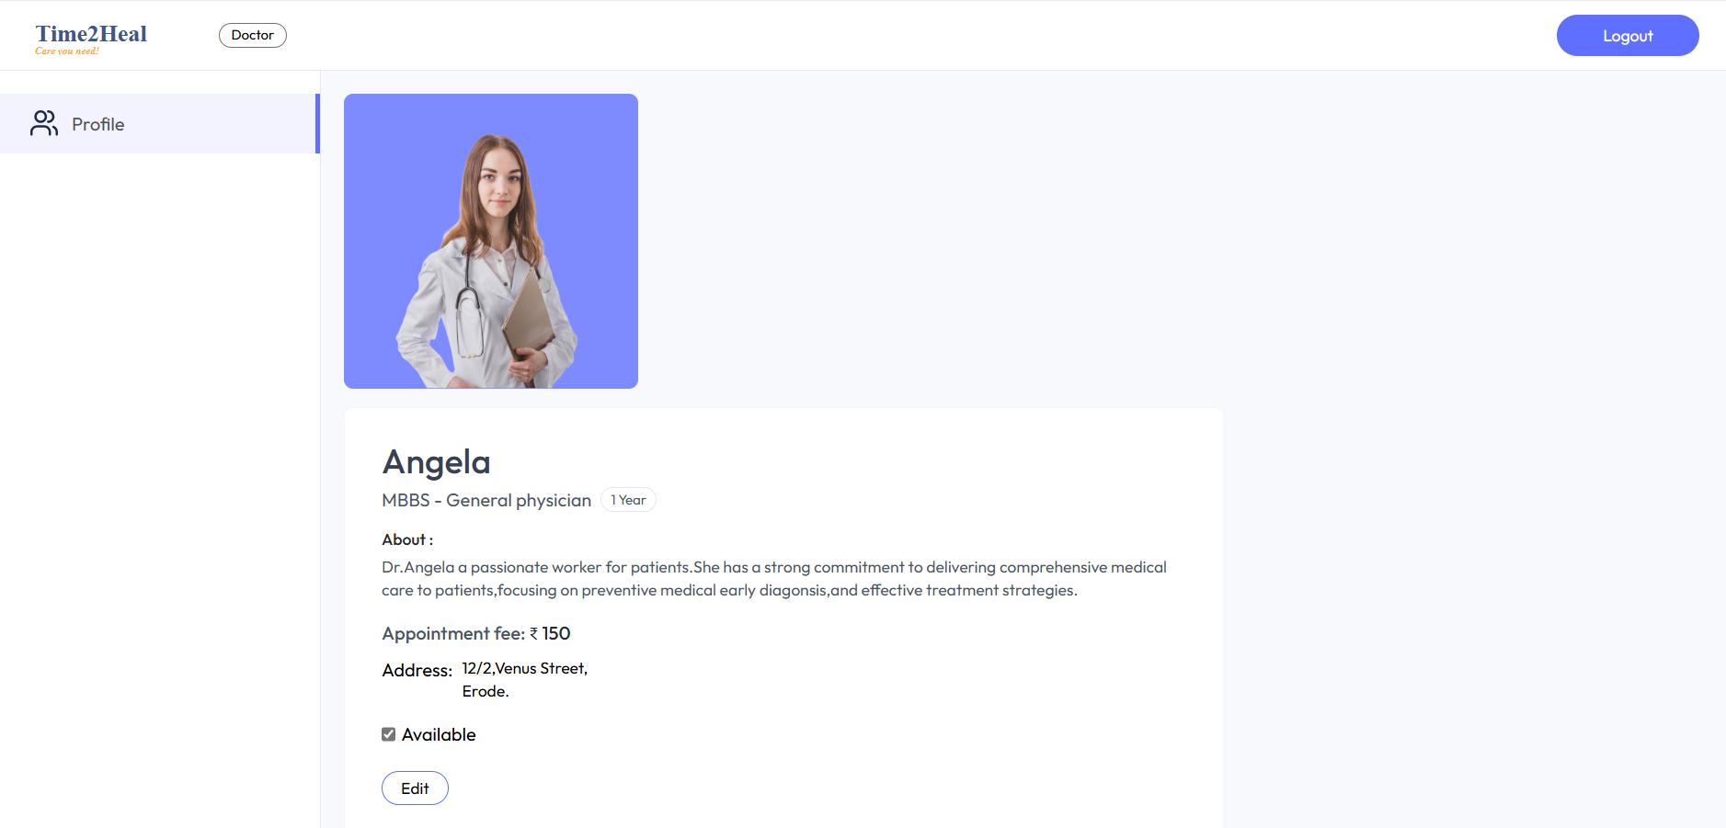
Doctors Profile

Slide 22
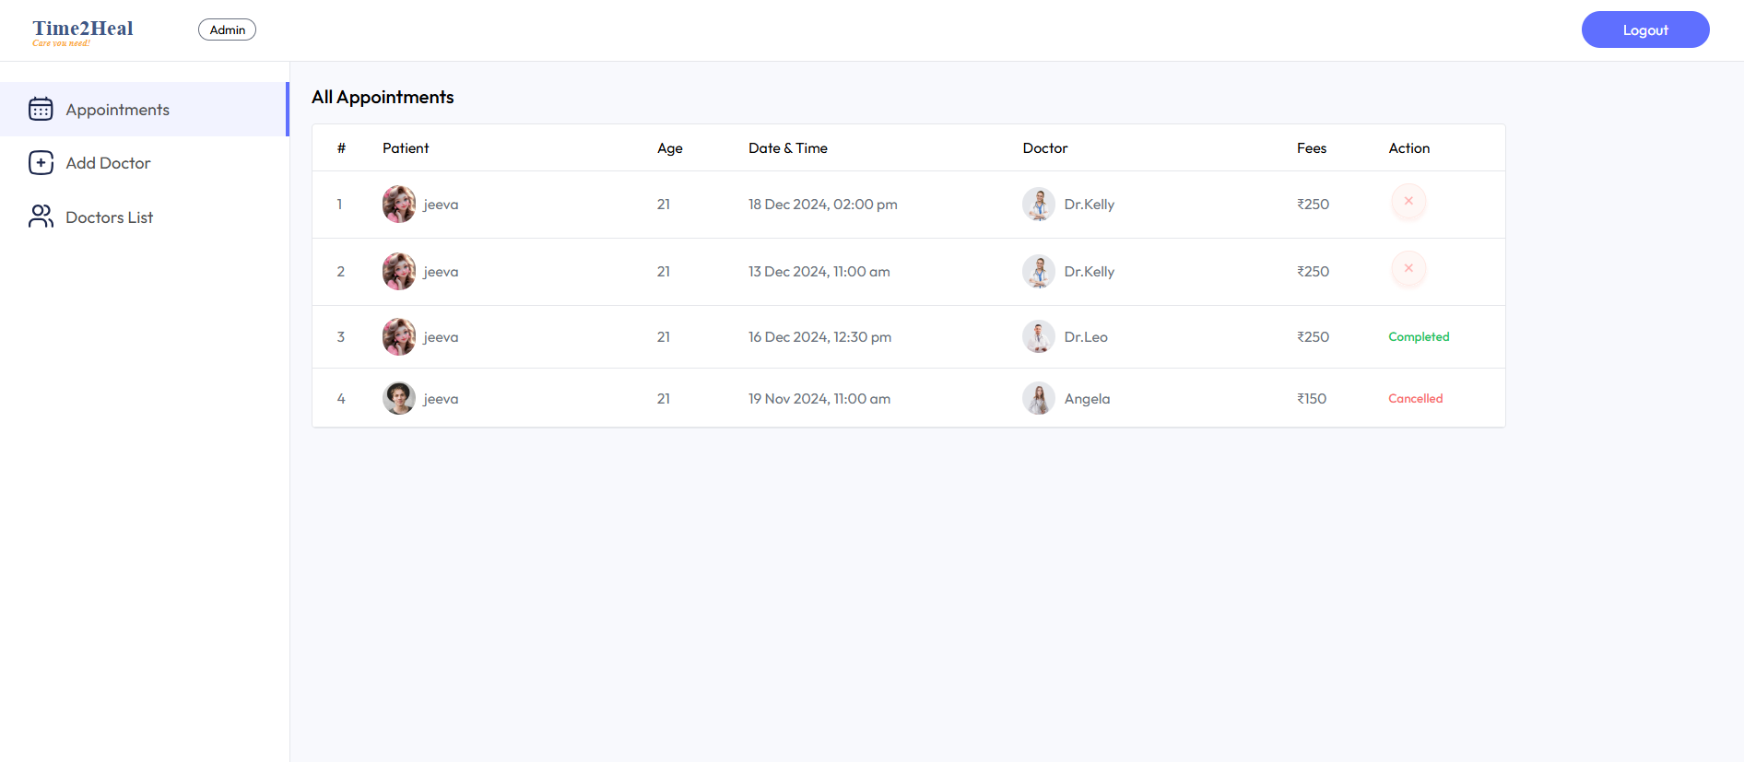
Admin Dashboard

Slide 23
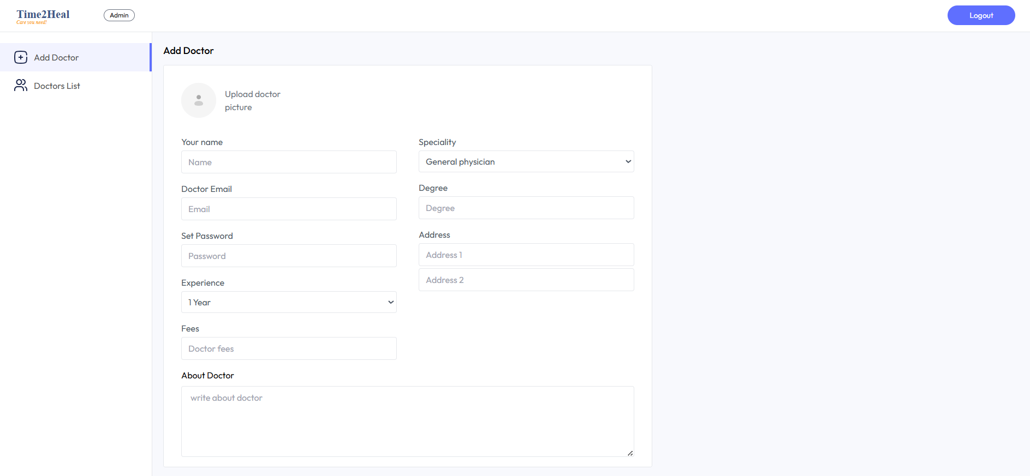
Add Doctors

Slide 24
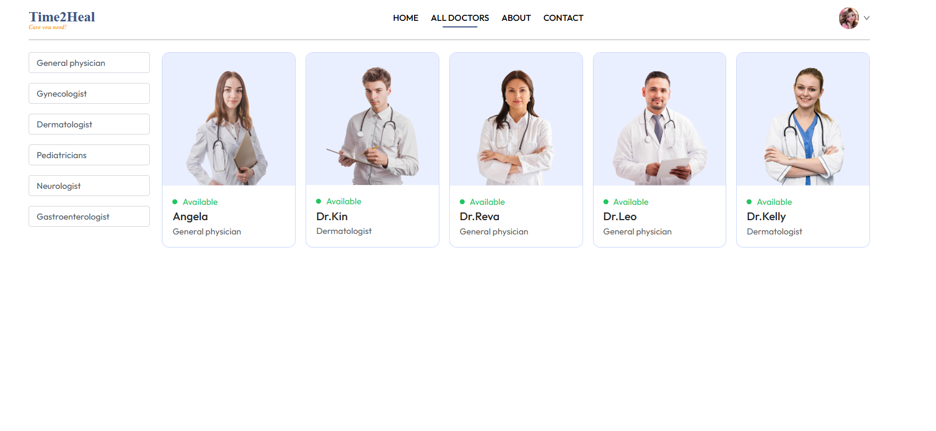
Doctors List

Slide 25
CONCLUSION:
An online doctor appointments represent a transformative advancement in offering enhanced accessibility, convenience, and efficiency for patients and providers alike. it is essential to address challenges such as technology access and data privacy to maximize its benefits.
Online appointments are reshaping the healthcare landscape, making quality care more attainable for a broader population.

Slide 26
THANK YOU!!

